Slide 1
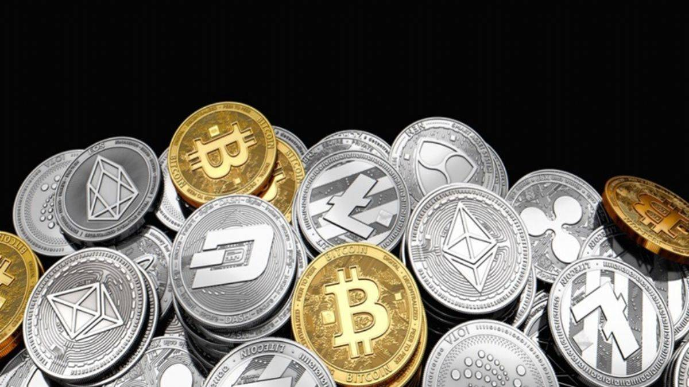
Introduction
ASSET-BACKED GLOBAL SECURITY TOKEN`S
`Finance for Asset Owners, Profit Opportunity for Investors`
Mike Johnson,Founder,New Jersey,US
www.globalfinanceplatform globaltrader@investorconnectus.com
WhatsApp +1(408)549-0515 `

Slide 2
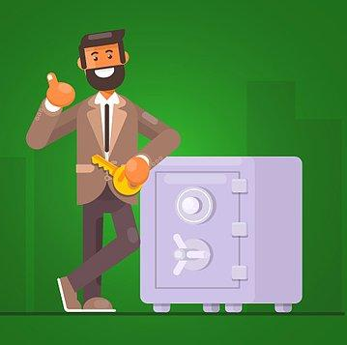
Problem
Owners, producers or sellers of assets with commercial value in world markets want to turn these assets into finance as soon as possible in order to compensate for the inventory and delayed sales costs that accumulate day by day.
On the other hand, users, buyers and traders of these products also want to buy these products in a more advantageous way than the market value.
In addition, Global potential investors also want to invest in reliable financial instruments indexed to assets.
What are the alternative practices and financial instruments that will bring these parties together and win?

Slide 3
Important Notes
Today, with the developments in crypto and blockchain technologies, it has become a sought-after practice to prepare all valuable commodity-based tokens in Etherium ERC-20 or ERC-721 token standards.
Tokenization is the process of putting ownership of valuable assets on the blockchain and offers the convenience of buying and selling these assets around the clock as transactions do not involve traditional intermediaries.
Large companies such as Deloitte, BNY Mellon, and EY have studied asset tokenization and have also concluded that it is an alternative model for financial transformation of assets across multiple industries, particularly the $9 trillion annual global securities industry.
Microsoft, Vanguard, and Sotheby's announced or launched projects representing industrial assets, securities, and real estate, respectively.
Bank of America sees the tokenization of real-world assets such as commodities, currencies, and stocks as "the main driver of digital asset adoption.". The asset-backed tokens are expected to reach 916 billion euros in Europe by 2026.
Problemin çeşitli çözümleri bunlardır:

Slide 4
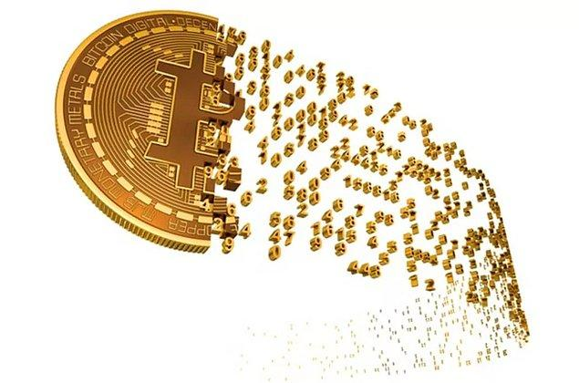
Solution and Product
Based on this global need and financial advantages, we have prepared ASSET-BACKED GLOBAL TOKEN`S
With this application; The process of tokenizing assets makes illiquid and high investment value assets easier to invest.
Digitizing assets and trading them on a decentralized-distributed ledger offers significant advantages to investors at all levels.
It provides the opportunity to invest in illiquid assets even in small amounts.
Our asset tokenization has the potential to bring trillions of dollars in real-world value to the blockchain.
Specifically, tokenized assets are a way to make countless assets more valuable, accessible and useful than their old counterparts.
Ethereum currently has a market capitalization of $64.35 billion. Ethereum tokens host a large number of digital assets built on top of the Ethereum blockchain. It lists over 900 major projects based on the popular ERC20 token standard alone.

Slide 5
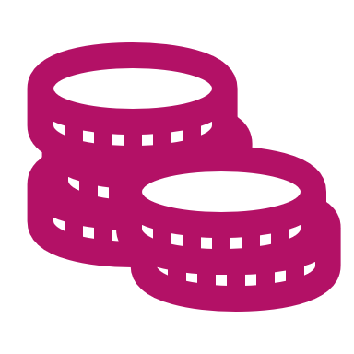
Solution and Product
ASSET BACKED GLOBAL TOKEN PLATFORM (AGT)is building a platform to tokenize $250 trillion worth of real-world assets. With listings on over 30 exchanges, AGT is quickly becoming the default stablecoin for traders looking for a regulated price-stable cryptocurrency.“
With ASSET-BACKED GLOBAL TOKEN`S tokenization, an asset can be represented as millions or even billions of tokens and create partial ownership, which can then be listed on various widely available and accessible exchanges.
This eliminates the need for costly transaction intermediaries and expands the pool of potential buyers while maintaining the liquidity premium as the tokens are tied to a unique asset.
An important benefit of tokenization is that since many blockchains are basically public, it allows all these records to be publicly tracked and audited.
With tokenization, investors can see their income or dividend yield, along with the ownership record, depending on the smart contract logic of the asset.
Asset-backed tokens can be collected in pools or baskets of different assets and compositions, creating tradable derivatives on the blockchain with links to real-world value.
It is now very easy to make payments or design balanced trades as these can be freely exchanged for each other on blockchain platforms, for example a DeFi wallet or a CEX or DEX site.

Slide 6
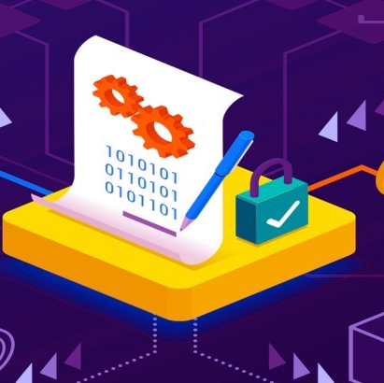
Asset Categories
For our Asset Indexed Tokens, the asset categories with the highest trading volume are;
Metals-Miners (such as gold, silver, platinum, diamond and copper, steel, aluminum, iron, nickel)
Energy Products (such as crude oil, natural gas, gasoline, aircraft fuel, LNG, LPG)
Agriculture Products (such as corn, soybeans, wheat, rice, cocoa, coffee, palm, cotton and sugar)
Real Estate Assets (With immovable assets such as fields, land, houses-buildings, commercial real estates, hotels, business centers, hospitals, etc.)
Financial investment instruments( such as “bonds”, “funds” and “sukuk” ...)

Slide 7
Procedures
Asset holders register with their assets (worth at least $50K) on the ASSET-BACKED GLOBAL TOKEN`S Platform.
Token preparation and purchase and sale agreements are made with registered asset owners.
With the contract, the amount of tokens to be prepared for their assets, their maturity and profit margin are determined.
Based on the contract, its assets are recorded in the JP Morgan Escrow account.
The asset indexed to the Asset Guaranteed Escrow account is recorded and listed in the (..........) ASSET-BACKED GLOBAL TOKEN`S Etherium with the name of the owner .
Investors' Token purchases are accumulated in their Etherium platform and owner account.
At the end of the specified maturity, principal and profit margin payments are transferred to the investors.
After Tokens are sold, Assets are released from Escrow after payments are made to investors

Slide 8
Sample Application
For example; For a US Residential Propane (I:USRPP) product sold at a market price of 2,671 USD/gal dated March 27, 2023,According to market prices, it wants to prepare 267 thousand dollars
Token for 100 thousand gallons of goods with a maturity of 6 months and a 10% profit margin.
The company enrolls 30% more 130 gallons of US Residential Propane at $374,230 in its JP Morgan escrow account.
Token investors will earn 10% profit according to the market prices of this product at the end of 6 months maturity.
The asset owner firm will also convert its stocks into finance in advance.
Once the transaction is complete, Escrow can release the registered goods or have them re-tokenized.
If the market value of the product has increased or decreased at the end of the 6th or 12th month, the token profit margin changes according to the current price of the product.
If the asset owner wishes, he can set a fixed trading and profit margin for the token to be prepared.

Slide 9
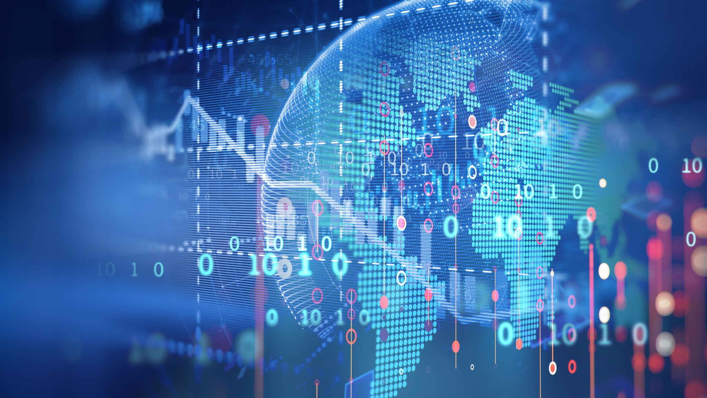
OUR INVESTOR NETWORK
FIRST OF ALL, WE PREFER INSTITUTIONAL INVESTORS WHO WILL INVEST 50,000 USD OR MORE. WE HAVE THE LARGEST NETWORK OF 5000 INVESTORS, FUNDS AND FINANCIAL INSTITUTIONS IN THE WORLD. DEMANDS AND OFFERS OF ASSET OWNERS ARE DIRECTED TO THIS NETWORK.
GLOBAL INVESTMENT PLATFORM
AMERICA-CANADA EUROPA ASIA AFRICA GULF-MIDDLE EAST BEST INSTITUTIONS IN THE WORLD
A- US STOCK EXCHANGES B- US COMMODITIES EXCHANGES C-CANADIAN STOCK EXCHANGES
K-US FUNDS- SECURITIES COMPANIES S-CANADA BANKS-FUND -SECURITIES COMPANY Z-LATIN AMERICA BANKS- FUNDS-SECURITIES COMPANY
E-EUROPEAN COUNTRIES COMMODITIES EXCHANGES J-ASIAN COUNTRIES COMMODITIES EXCHANGES H-AFRICAN COUNTRIES COMMODITIES EXCHANGES
P-BEST SOVEREIGN-WEALTH-HEDGE FUNDS IN THE WORLD T-ASIAN BANKS-FUNDS-SECURITIES COMPANIES U-GULF FUND SECURITIES COMPANIES N-BEST FUNDS-ASSET MANAGEMENT FIRMS IN THE WORLD V-ISLAMIC FINANCIAL INSTITUTIONS

Slide 10
Our Group Services
Our Global Finance Platform & InvestorConnectUS & MyInvestSupport & GlobalTrader & GulfUSCapital group
Provides escrow registration of assets,
Preparation of asset indexed Tokens,
Product configuration on Etherium,Coinbase,Stripe, DocuSign, Wallet Connect, Sum Sub and other platforms,
Management of tokens services to investors.

Slide 11
ASSET-BACKED GLOBAL TOKEN`S APPLICATION
You can fill out this form to participate in the "Asset-BACKED GLOBAL TOKEN`S" Platform, which provides 'Financing to Asset Owners and Income to Investors,' Risk-Free-Safe-Profitable-Income- Generating.
The platform connects Global Investors with Asset-linked Token holders.
Investment Search – Investor Connect Us

